Slide 1
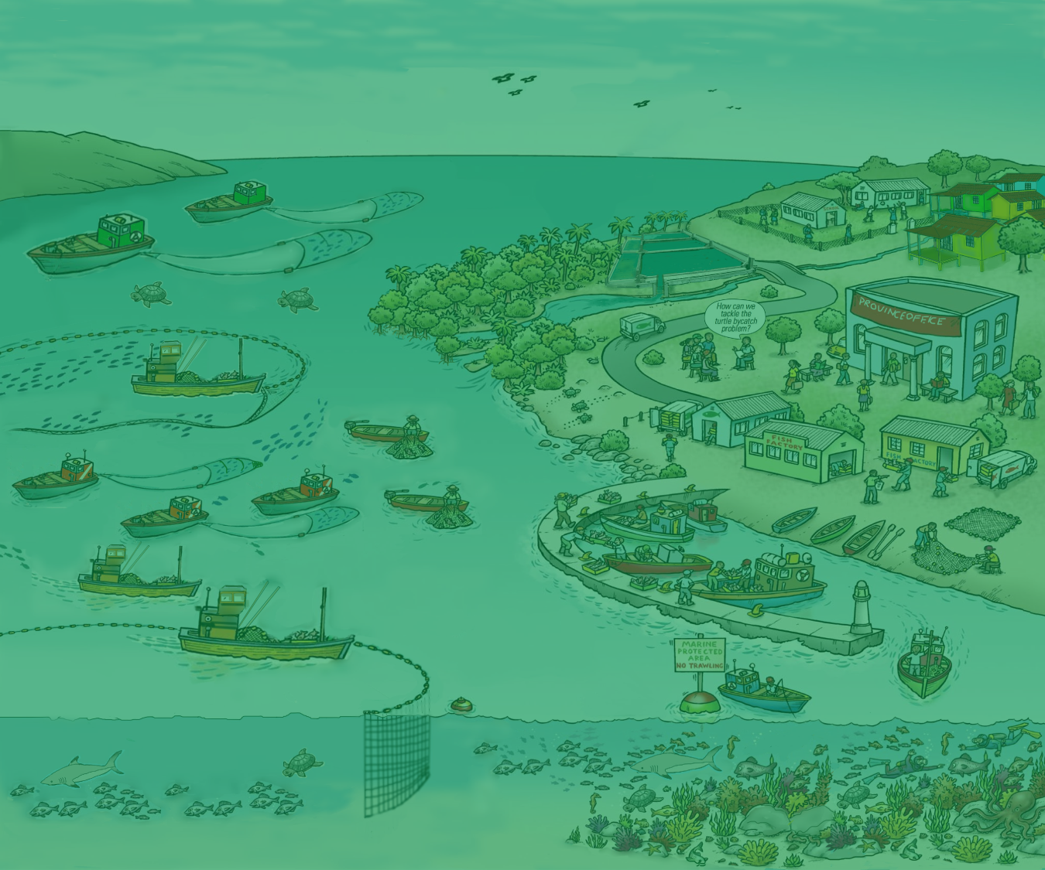
8. EAFM Institutional and Management Structures
Version 1

Slide 2
Session objectives
After this session you will be able to:
Identify existing EAFM institutions and management structures
Identify future EAFM institutions and management structures
Identify challenges, gaps, needs
2
Notes:
Self explanatory

Slide 3
Institutional and
Management Structures
EAFM requires engagement across multiple sectors affecting the fishery ecosystem
- for example, fisheries, environment and climate, as well as associated sectors like mining, energy, agriculture, and tourism.
Many of the issues outside of the mandate of fisheries agencies
- governance under EAFM includes the coordination and cooperation between government agencies at different levels.
3
Notes:
EAFM requires coordination across multiple sectors and many of the threats and issues may lie outside the mandate of a fisheries agency, but it is important that the fisheries agency actively engages with these other actors

Slide 4
Institutional and
Management Structures
Sharing data and information
Harmonizing work plans and budgets
Working together in advisory committees
4
Notes:
For a start, it is important to share data and information and if common goals can be found then harmonizing work plans and budgets may be possible

Slide 5
Who is involved in the management governance framework?
Government
Fisheries
Environment
Fishers
Fisher associations
Advisors
NGOS
Researchers Academics
EAFM
Other Users
Tourism, Ports etc
Fisheries dependents
Boat owners, Traders etc
MCS
Navy, Coast guard, etc
Notes:
Stakeholders:
Who should be represented on these Councils and MACs? Obviously, we would have Government – at least Fisheries and Environmental Departments, then we would have Fishers, perhaps represented by Fisher Associations
Ideally we would include other users, for example Tourism and Ports.
Importantly, agencies responsible for Monitoring, Control and Surveillance are included, as are
Next would be the people dependent on the fishery such as boat owners, money lenders and middlemen through the value chain,
Advisors, such as NGOs, researchers and academics are also important stakeholders.
All these stakeholders are linked through EAFM

Slide 6
Governance arrangements for a FMU?
Community
VC
VC
VC
VC = Village Committee
MAC = Management Advisory Committee
District
MAC
MAC
MAC
Provincial
FMU MAC
Other sectors
Department of Fisheries
Navy/
coastguard
Department of Environment
National
Council
Notes:
The FMU governance structure will depend on the type of FMU being managed. Small local fisheries will obviously have a different structure from a highly migratory transboundary fishery. In this example, we will build a structure based on an area FMU, such as the FMUs in Indonesia. This FMU covers both small-scale and large-scale fishing in a defined area along the coast and out to the limit of the EEZ.
* At the community level we could have coordination among village communities (VCs) that link at the District levels, we could have Advisory groups , one for each District, made up of representatives of village Committees.
These are called “Management advisory committees” in this animation, but could be called “District Fisheries Consultative Groups”, or whatever is appropriate.
At the Provincial level, we could have MACs again. These Macs would report to the Department of Fisheries that is at the centre of the governance frameworks.
At the National Level we could have a mechanism that coordinates the Department of Fisheries, the Environment Department, the navy/coastguard and other agencies responsible for compliance and enforcement, and other users such as Forestry, Agriculture, Tourism and shipping.
An overarching Council could be responsible for all the governance structure.
Obviously, there are many variations to this structure. For example, there could be Area/fishery Councils.

Slide 7
National government fisheries agency structure?
Ministry of Agriculture, Forestry & Fisheries
Department of Fisheries
Admin Section
Post-harvest:
Food quality
Section
Foreign Affairs
Section
MCS Section
Fisheries Manage-ment Section
Policy Section
Research Institutes
Notes:
Next Slide
Lastly, we need to look in-house. In a typical Ministry of Agriculture, Forestry and Fisheries there is probably a Department of Fisheries (or something similar with a different name such as a Fisheries Administration). With this Department there will be a number of Divisions or Sections, for example an Administration Section, a Post-harvest Seafood quality section, a Foreign Affairs Section, a Policy Section and Research Institutes.
Important Sections that are often missing are a Monitoring, Control and Surveillance Section and a Fisheries Management Section.

Slide 8
National government fisheries agency structure?
Ministry of Agriculture, Forestry & Fisheries
Department of Fisheries
Admin Section
Post-harvest:
Food quality
Section
Foreign Affairs
Section
MCS Section
Fisheries Manage-ment Section
Policy Section
Research Institutes
Notes:
Having a well-staffed Fisheries Management Section and MCS Section is critical to implementing EAFM. Without these, it will be very difficult to implement EAFM

Slide 9
Activity: Institutional and
Management Structures
What existing institutional and management structures exist for coordinating natural resource management (i.e., ICM, IWM)?
What existing institutional and management structures exist for coordinating fisheries management?
How well do different agencies of government work with each other?
9
Notes:
STARTUP A is getting organized and preparing the ground.
Many of the tasks in STARTUP A are only done once at the beginning of the process.

Slide 10
Activity: Institutional and
Management Structures
What are the opportunities in your existing structures to support EAFM?
What are the gaps in your existing structure to support EAFM and what modifications would you make to move toward an EAFM?
What other levels of government should you collaborate with?
What other sectors (i.e. police, shipping, tourism, agriculture, development) should you collaborate /engage with?
10
Notes:
STARTUP A is getting organized and preparing the ground.
Many of the tasks in STARTUP A are only done once at the beginning of the process.

